Slide 1

New Initiatives
Western North Region
2015

Slide 2

Dialog Customer Tracer

Slide 3


Dialog Complaint
Low Signal

Slide 4



Dialog Complaint Situation

Slide 5

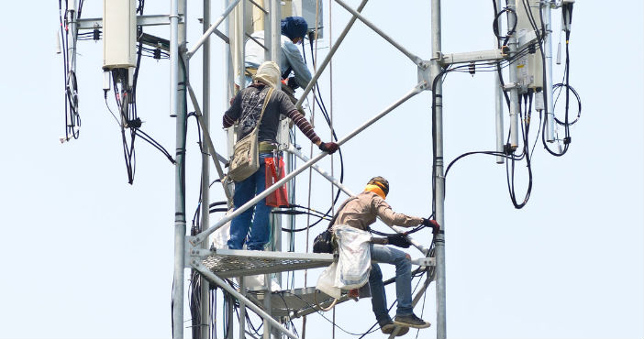

Visiting Customer Location

Slide 6
Dialog Complaint Situation
Get Complaint Data From Seibel.
Calling The Customer And Asking The Location.
Heir A Vehicle And Visiting The Customer .
Asking The Road While Visiting The Customer.
Calling Again And Asking Whether The Visiting Team,
Arrived The Correct Location.
Checking Customer Location By Visiting Team.
Checking Low Signal Areas At Customer Premises .
Visiting The Site Locations And Antenna Optimization.
Get Feedback And Close The Customer Complaint.

Slide 7
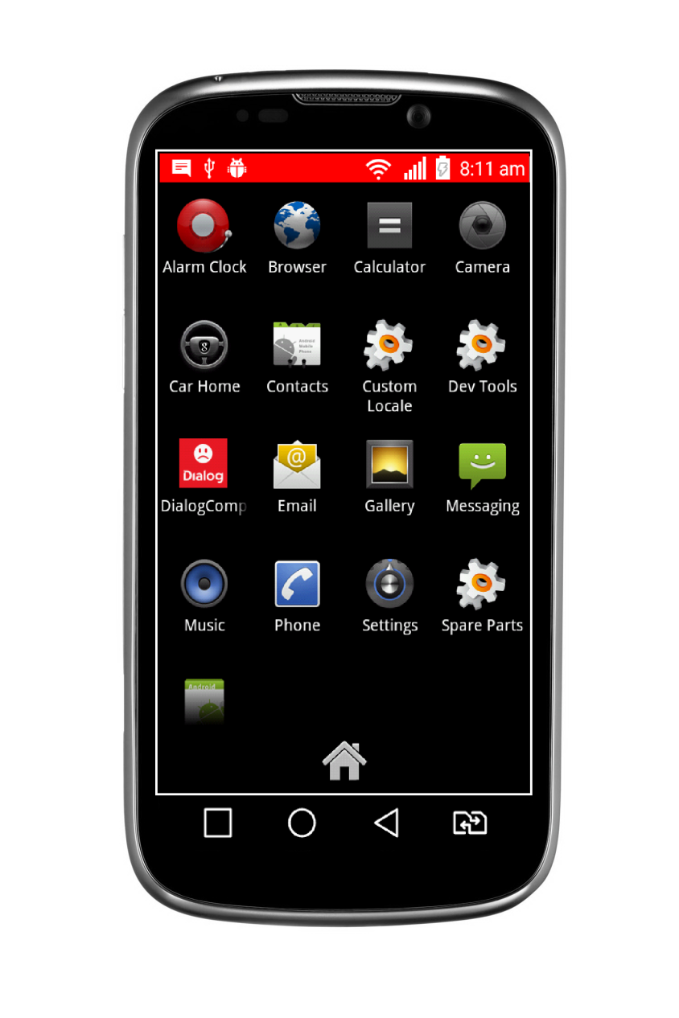
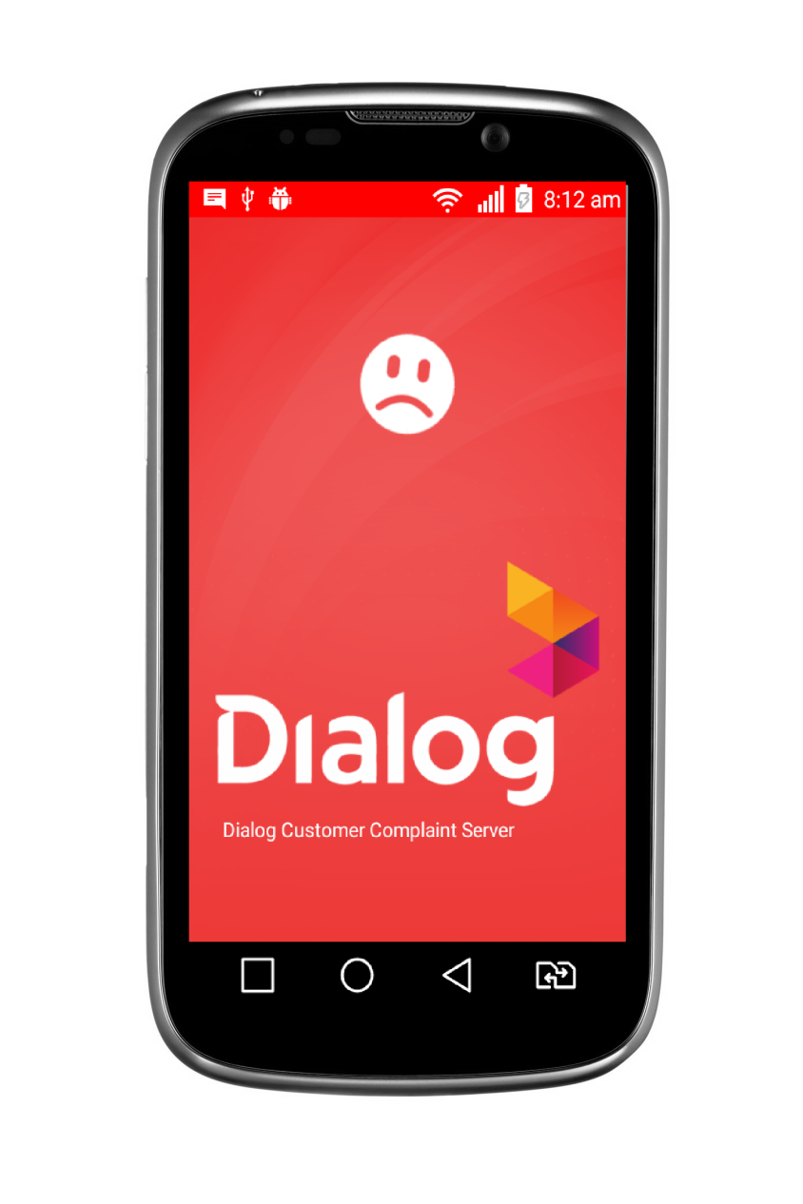

Complaint Visiting Solution

Slide 8
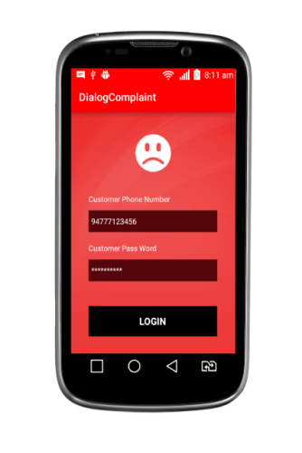
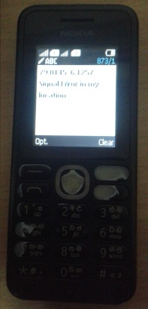
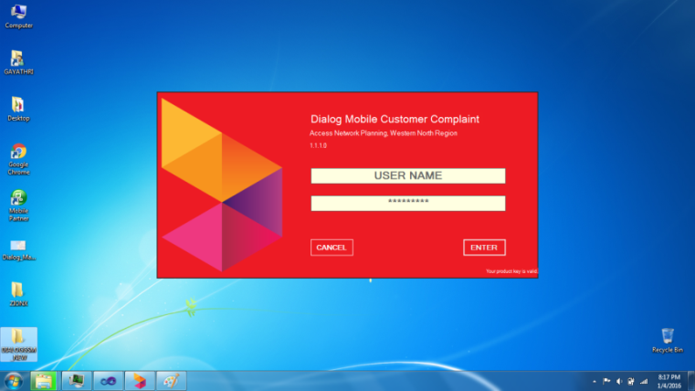
Dialog Customer Tracer
Gsm Message
Server
Customer Tracer
For Mobile
Customer Tracer For PC

Slide 9
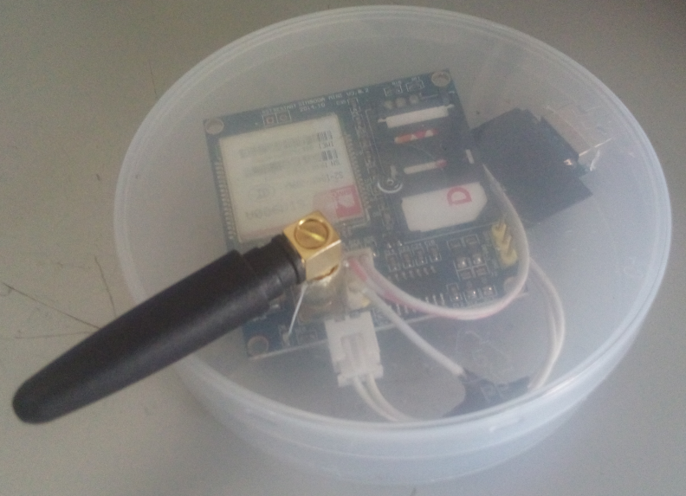
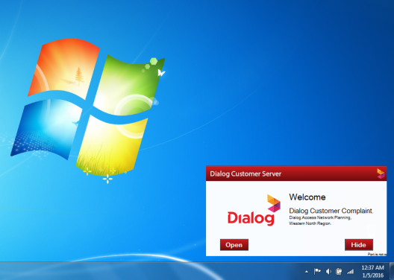
Dialog Gsm Message Server
Hardware
Software

Slide 10

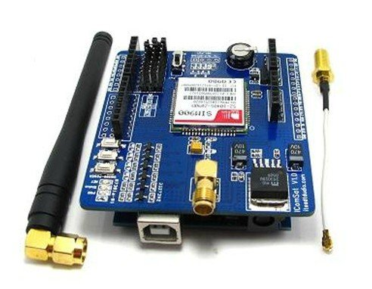
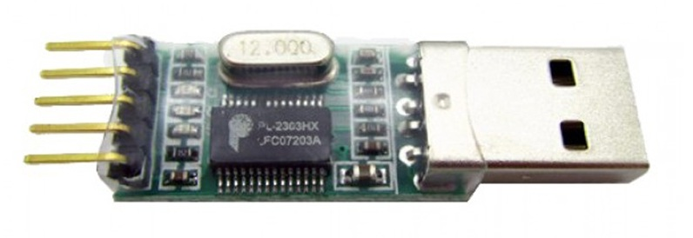
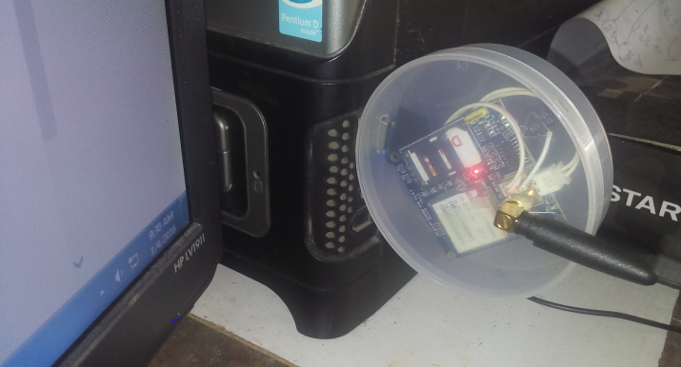
GSM Module SIM 900A
Hardware
SIM 900A
USB To TTL (Rx,Tx) Converter
Any PC
(Computer)

Slide 11
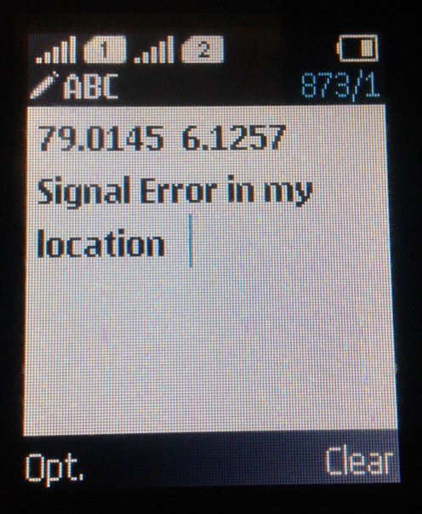
Gsm Module SIM 900A
Hardware
Read Message From Customer And, Function The Message
SMS FOR UPDATING CUSTOMER LOCATION :
<LOG> _ <LAT> _ <COMPLAINT>
7.5343 80.4532 This is my location
SMS FOR CHANGING CUSTOMER PASSWORD :
PASS _ <NEW PASS> _ <OLD PASS>
PASS NewMY#*@Pas old#$129pASS
SMS FOR DIALOG USER RESTATRT COMPUTER :
OFFPC _ <PASS WORD> _
OFFPC NewMY#*@Pas
Any PC
(Computer)
Online Server
(Computer)

Slide 12



Mobile Customer Tracer

Slide 13






Mobile Customer Tracer
Android Codes
Java
Xml
Sope
ASP.NET URL LINK
ASP.NET
C#
Dedicated Server
MS SQL

Slide 14
Mobile Customer Tracer
Customer Add New Complaint.
Get Customer Location Details.
Get Customer Signal Details.
Trace Customer Signals.
Get Customer Neighbor Cell Information
Get Customer Download Upload Speed (Hoping To Develop).
Send And Get Customer Feedback.
Change Customer Login Pass Word.

Slide 15
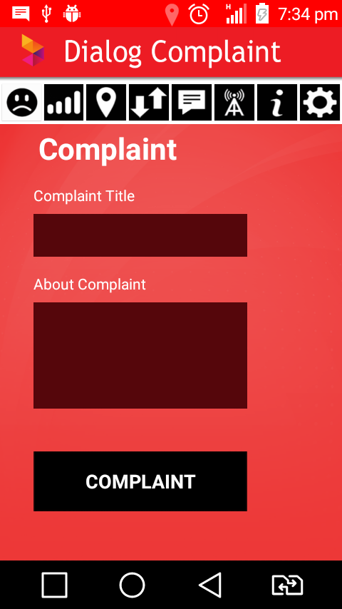
Tracer New Complaint
Customer Name
Customer Complaint Data
Send Button

Slide 16
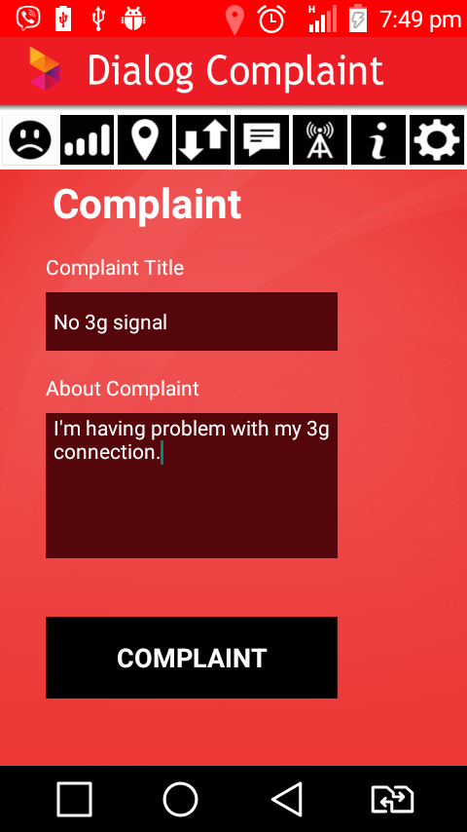
Customer Location Tracer
Get Customer Complaint
Get Customer Location
To send the complaint,
customer GPS location must be needed

Slide 17
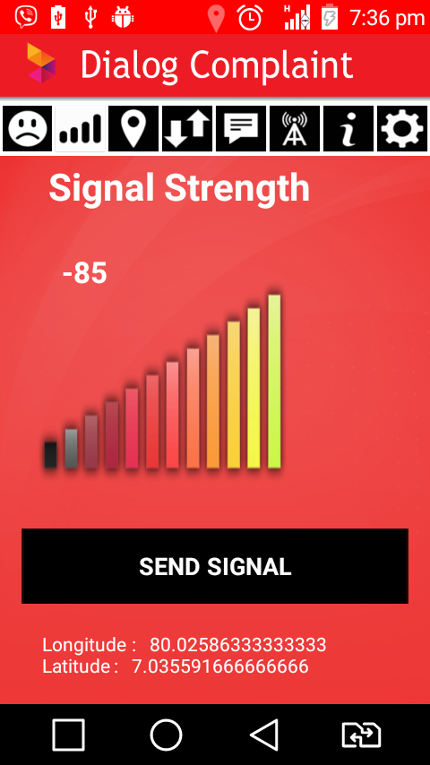
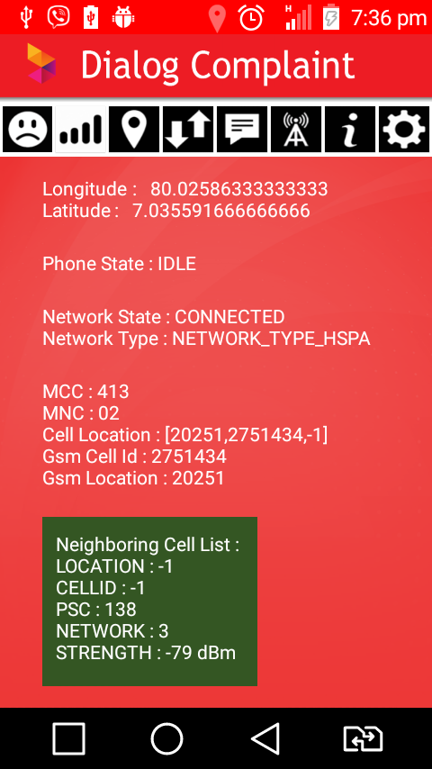
Send Customer Signal Data
Signal Strength
Send Button

Slide 18
Customer Other Signal Data
GPS Longitude
GPS Latitude
Serving Cell Strength
Serving Cell ID
Call Mode – IDLE
Call Mode – RIGING
Call Mode - CALLING
Network Type
Neighbor Cell Signal Strength

Slide 19
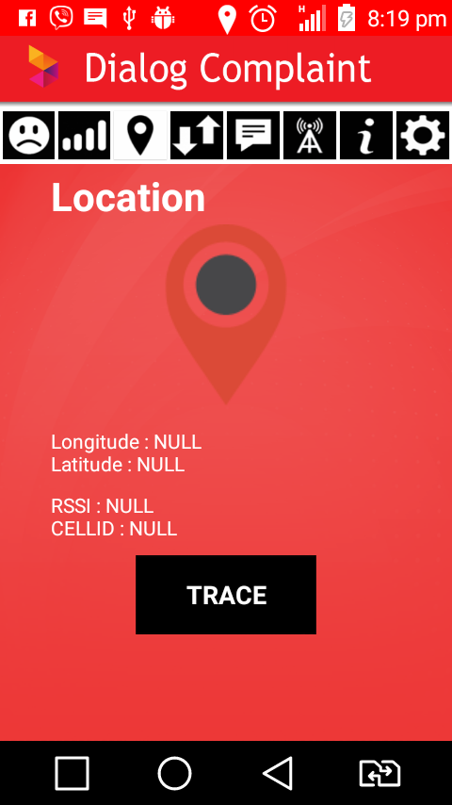
Future Developments
Drive Test
Signal Trace
With Location Trace

Slide 20
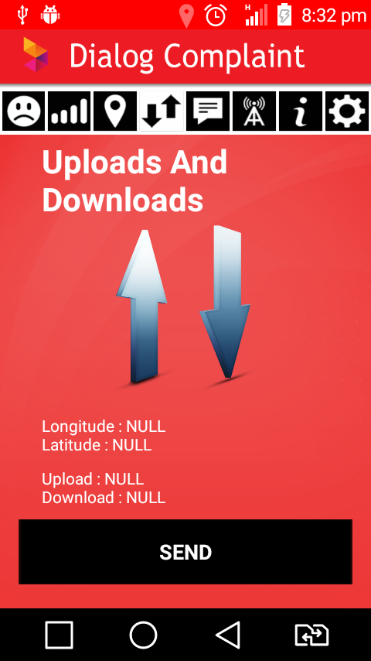
Future Developments
Get Customer Download Speed
Get Customer Upload Speed
With Location

Slide 21
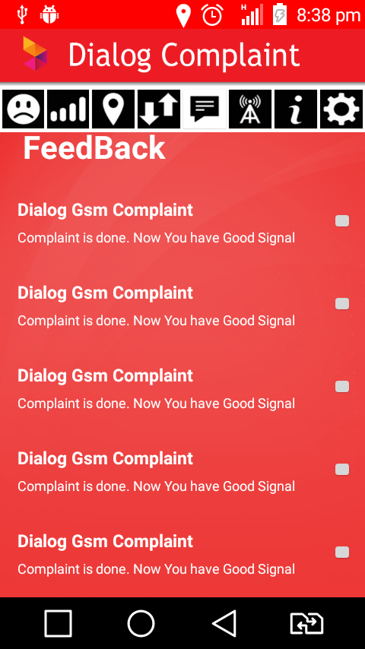
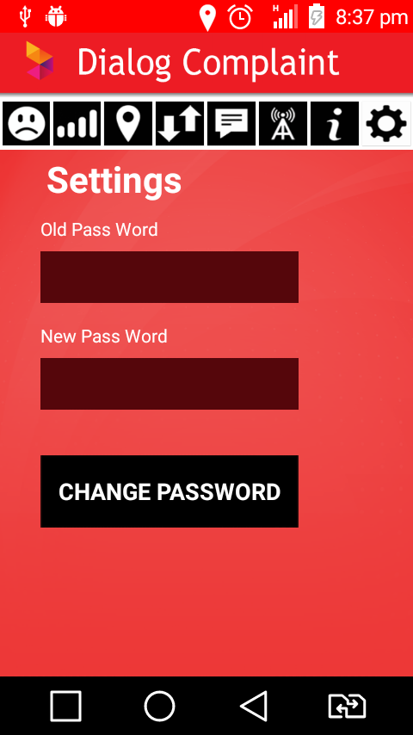
Other Options
Feed Back
Settings

Slide 22

Customer Tracer User PC

Slide 23
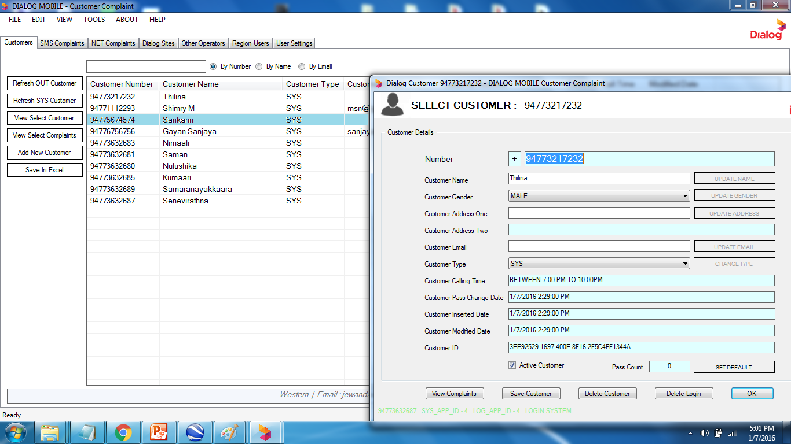
View Customer Details

Slide 24
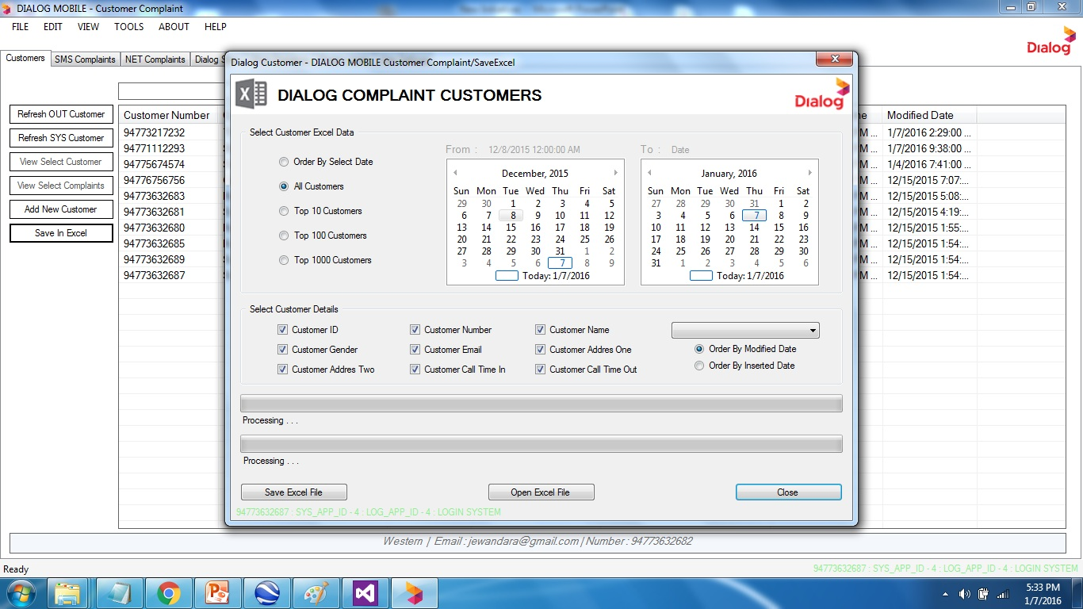
Export To Excel

Slide 25
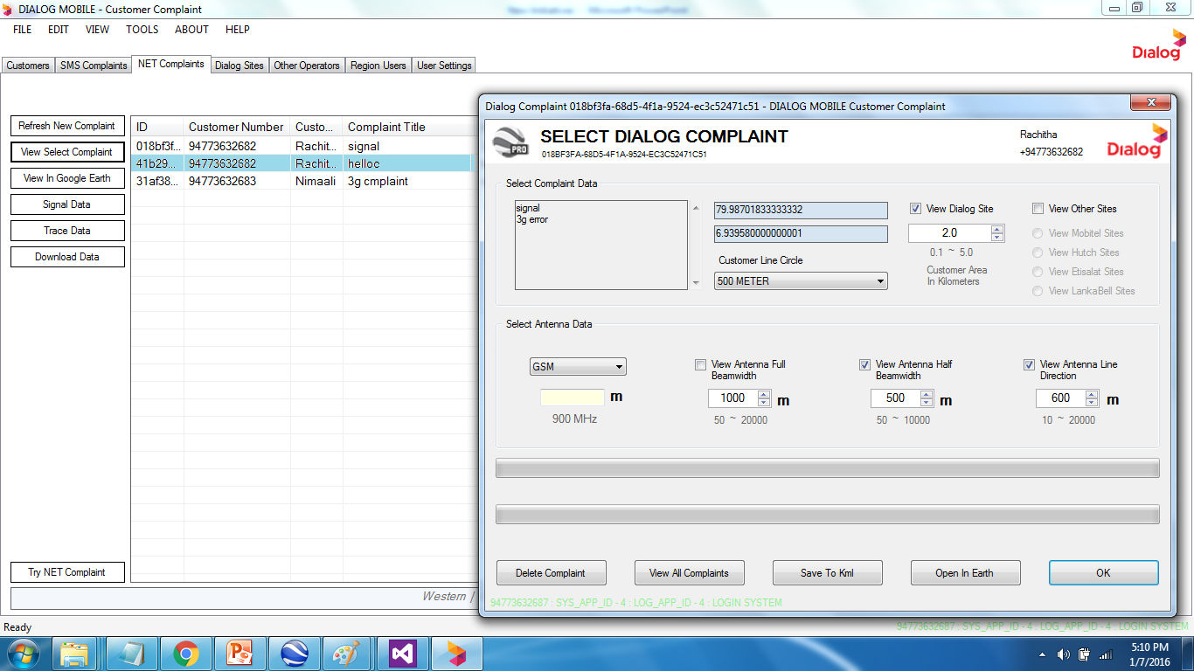
View Mobile Complaints

Slide 26
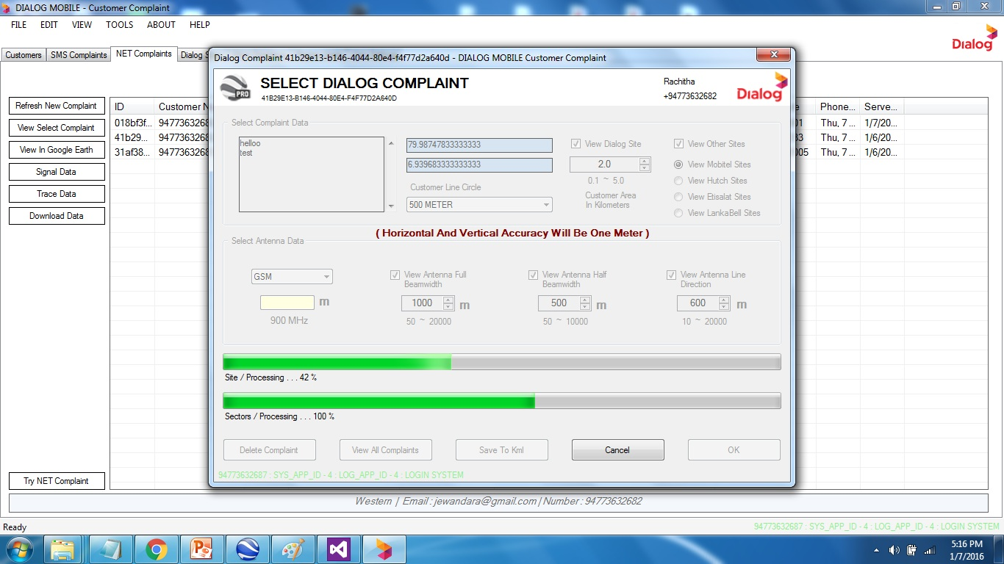
View Customer In Google Earth

Slide 27
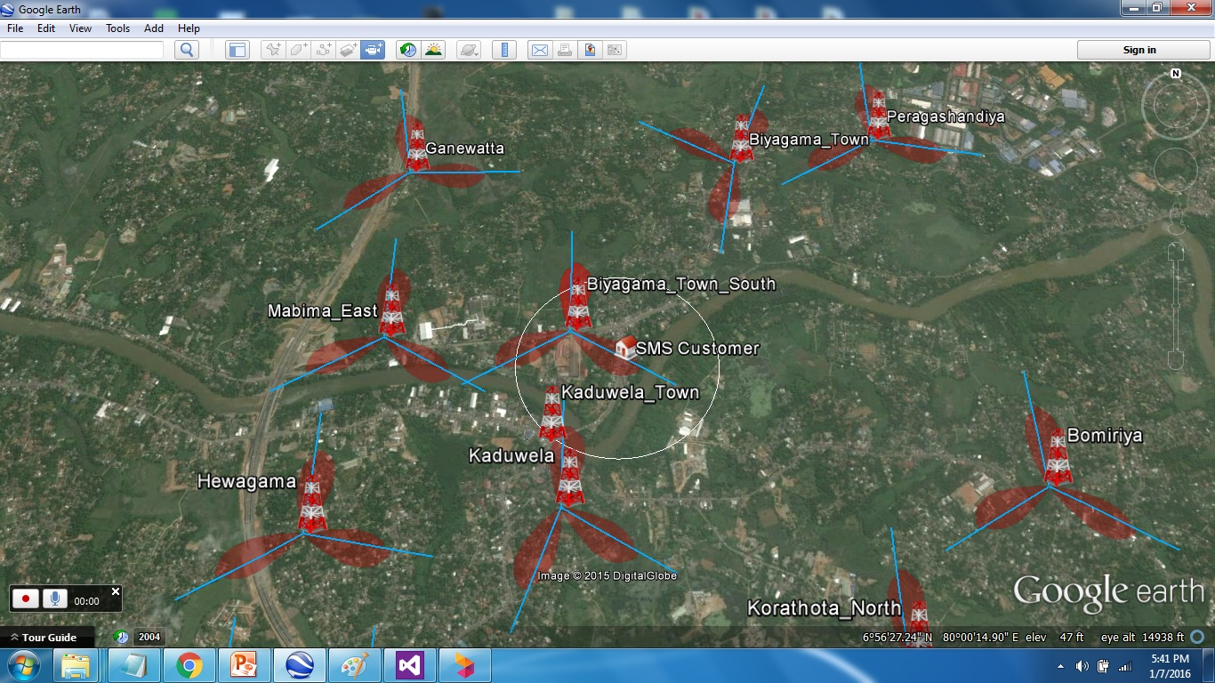
View Customer In Google Earth
Customer Location

Slide 28
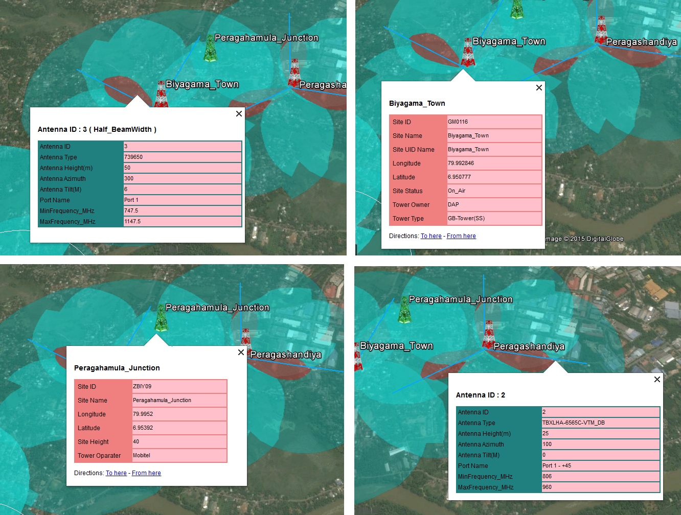
View Tower Details

Slide 29
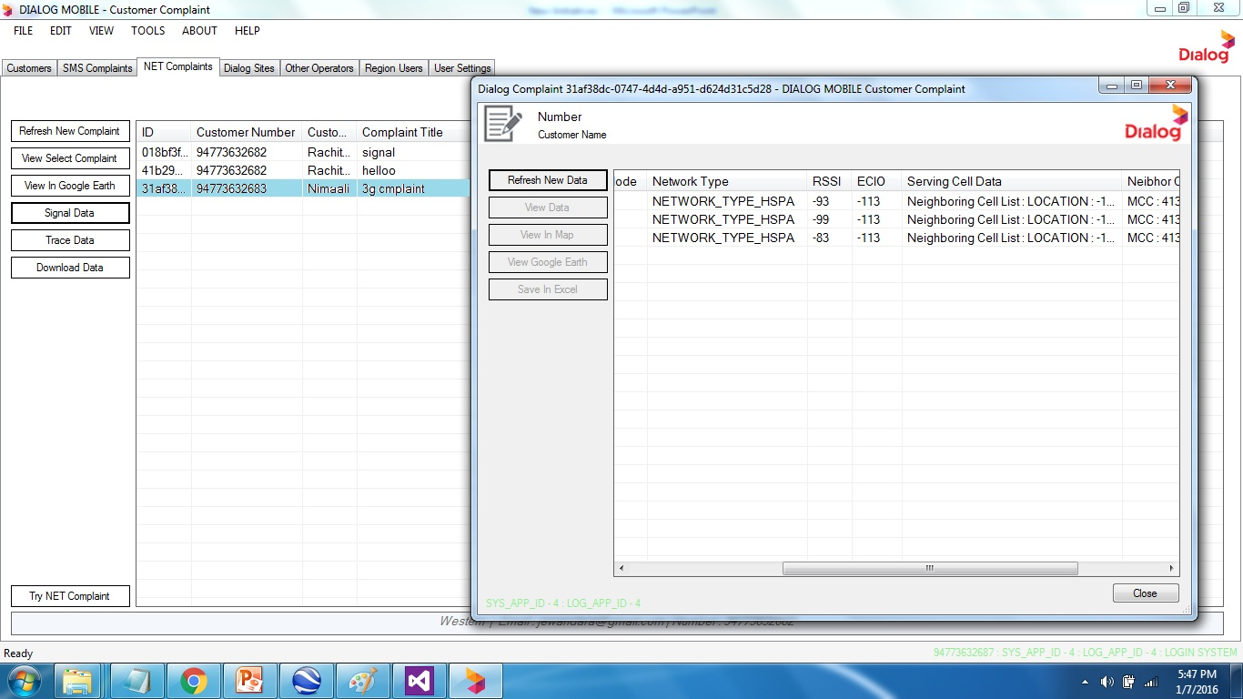
View Signal Information

Slide 30
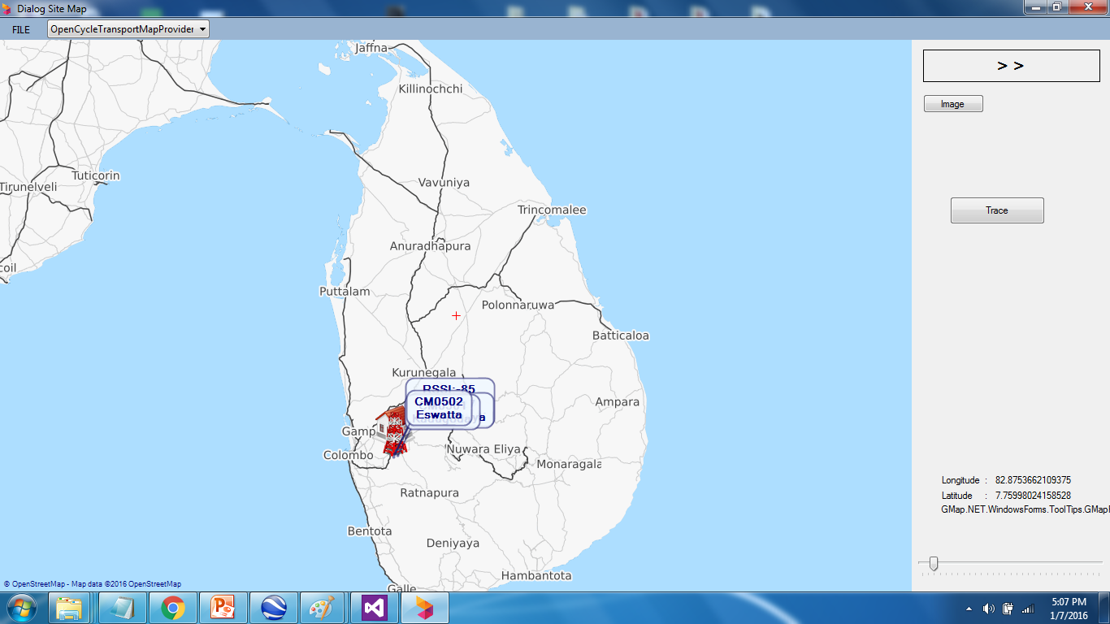
View Customer Cell Information

Slide 31
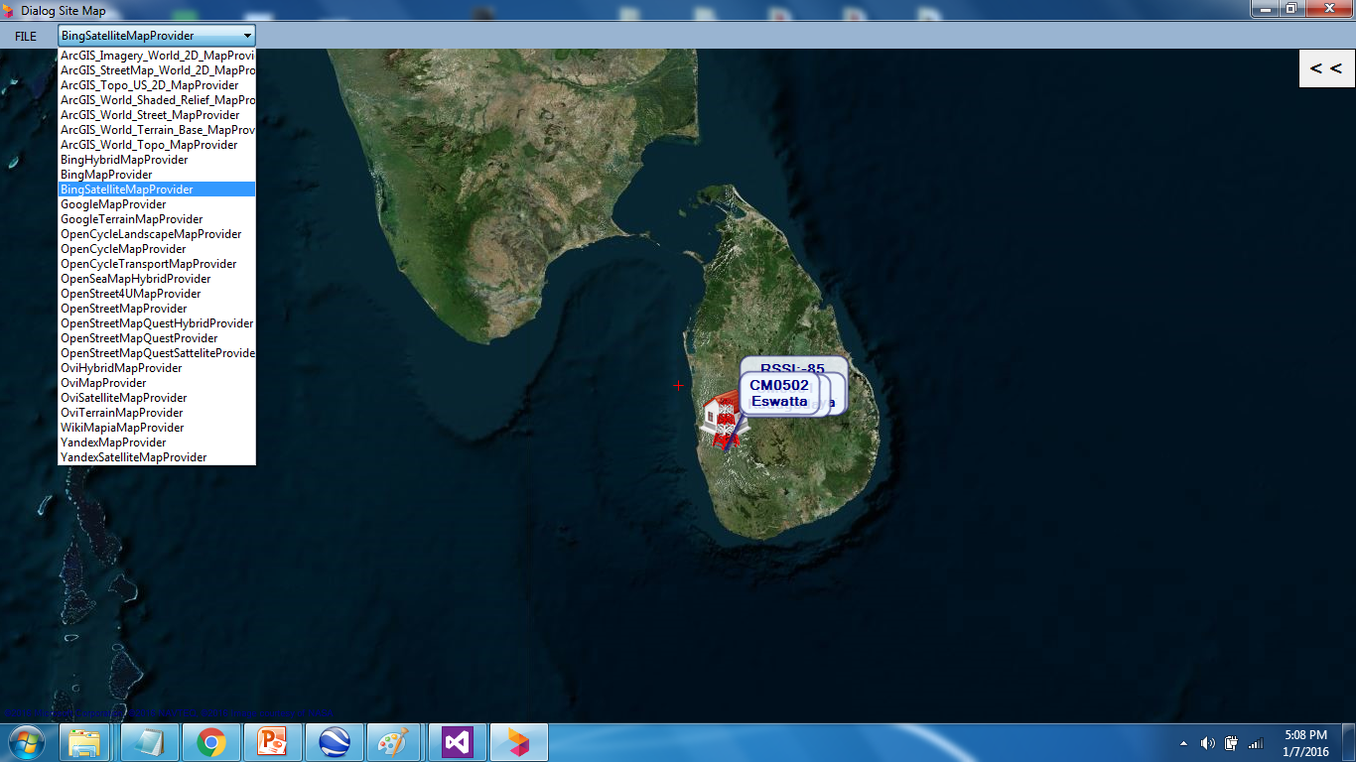
View Location In Different Type Of Map Providers

Slide 32
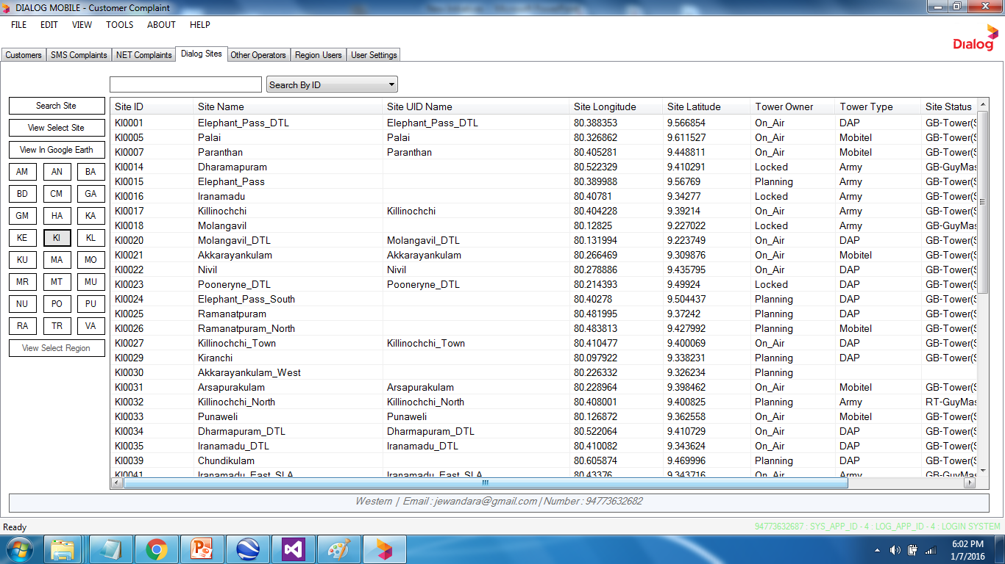
View Site Details

Slide 33
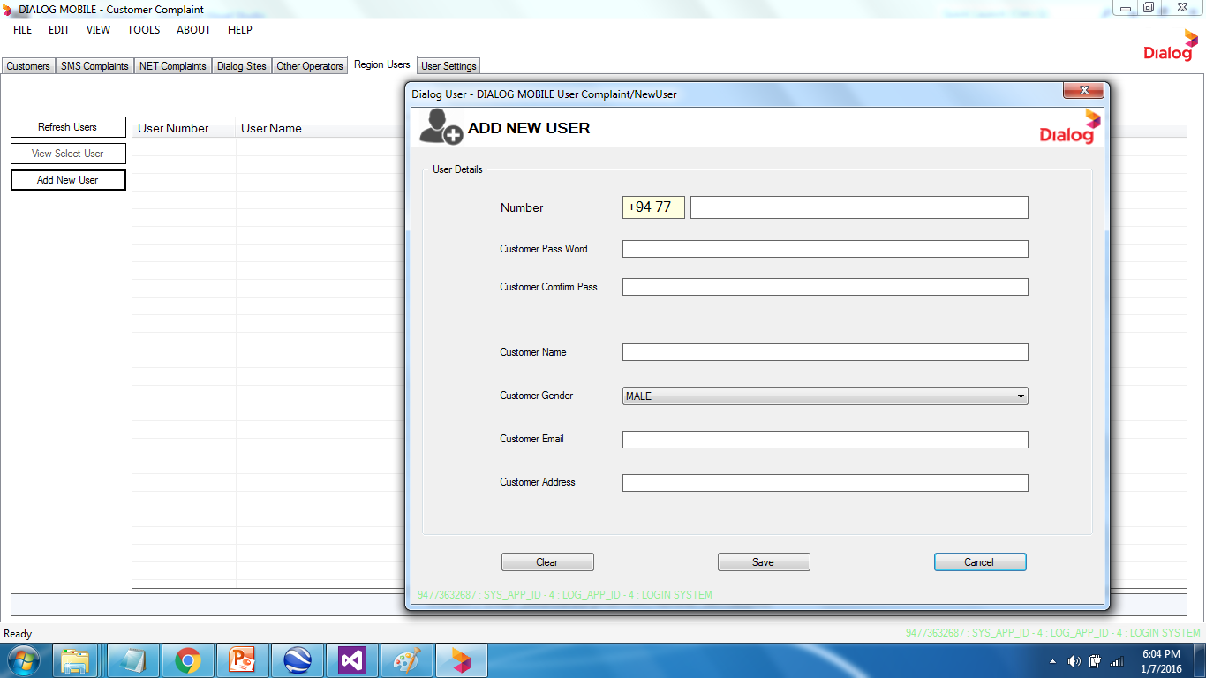
Future Developments
Create Region Users

Slide 34
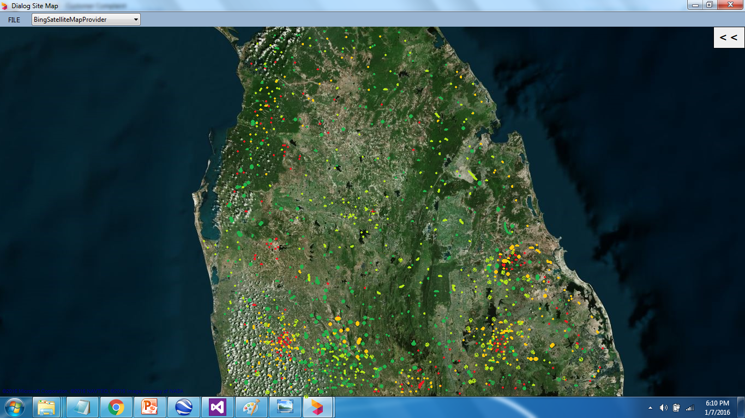
Outcomes
Get All Complaints To One Map

Slide 35
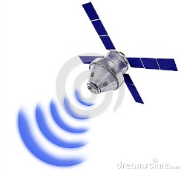



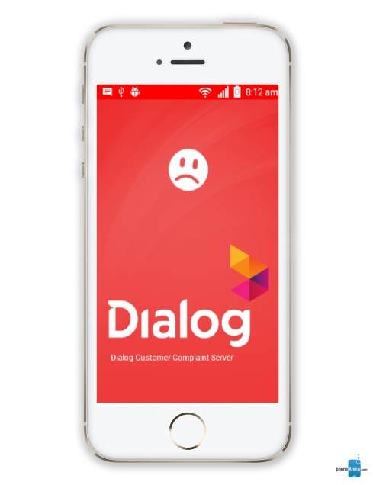
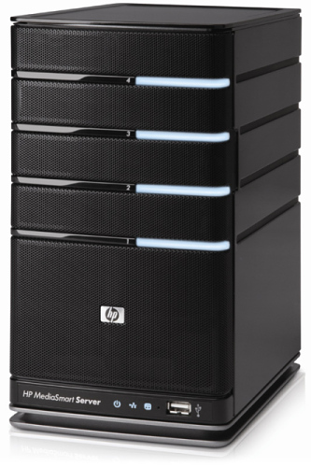
Customer
Support Team
Server

